Slide 1

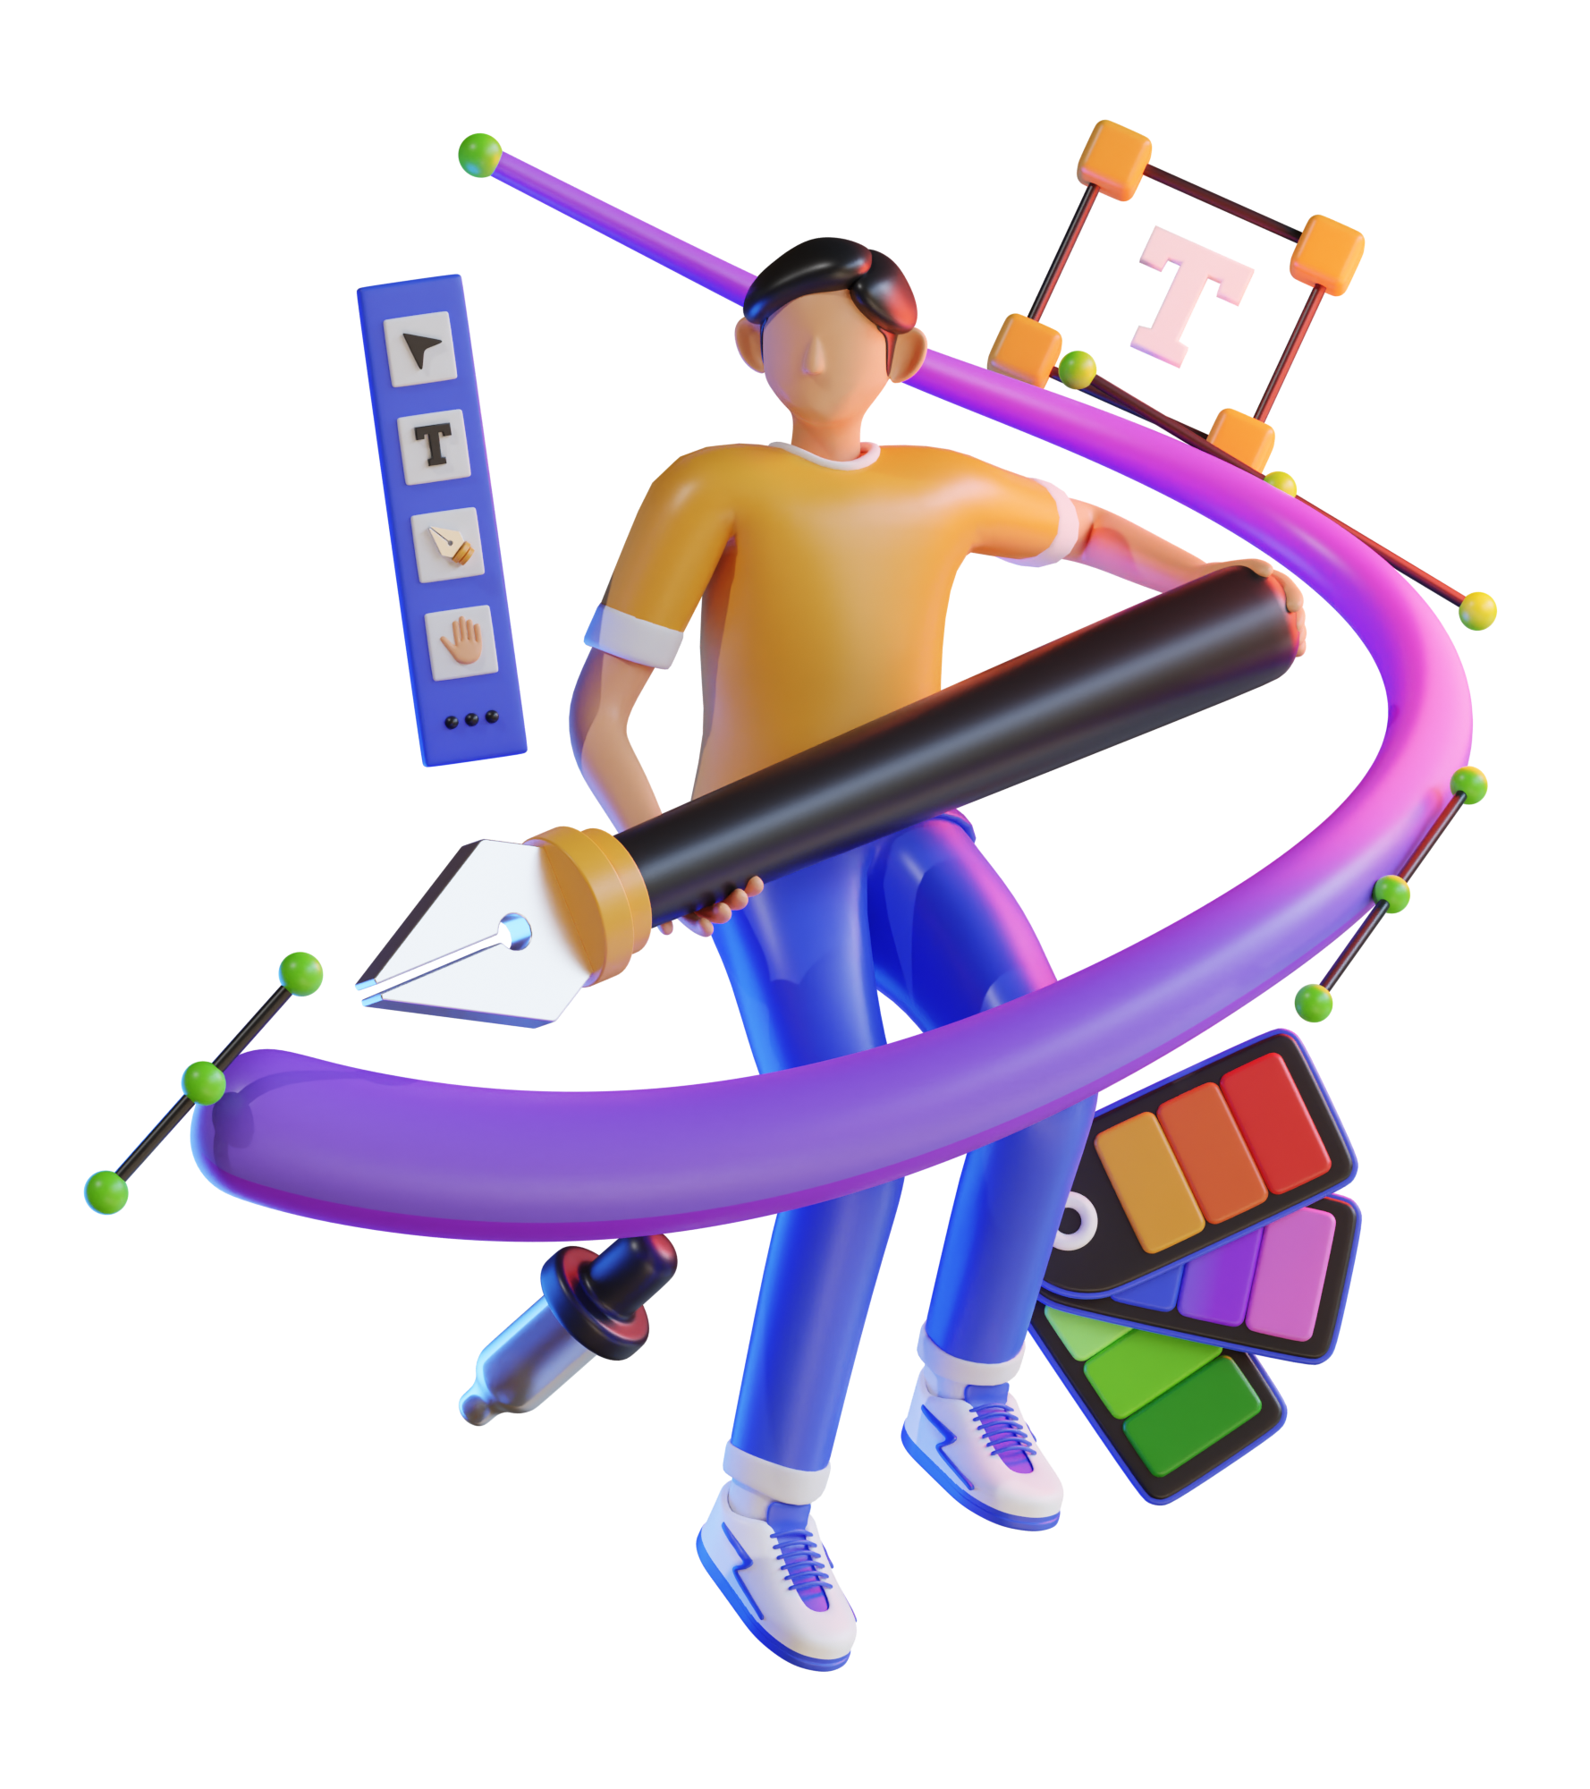

PLATFORM BASED
FRONTEND DESIGN
DEVELOPMENT
Frontend design refers to the user-facing part of a website or web application. It’s what you see when you visit a site, such as the layout, buttons, images, and overall visual appearance.
FRONTEND DEVELOPER
A frontend developer is responsible for building the client-side of websites and web applications.
CHRISTIAN BARTE
Developer

Slide 2


FRONTEND DESIGN
PROBLEM
Frontend design refers to the user-facing part of a website or web application. It’s what you see when you visit a site, such as the layout, buttons, images, and overall visual appearance.
process can be time-consuming
existing generators are scattered
FRONTEND DEVELOPER
A frontend developer is responsible for building the client-side of websites and web applications.

Slide 3
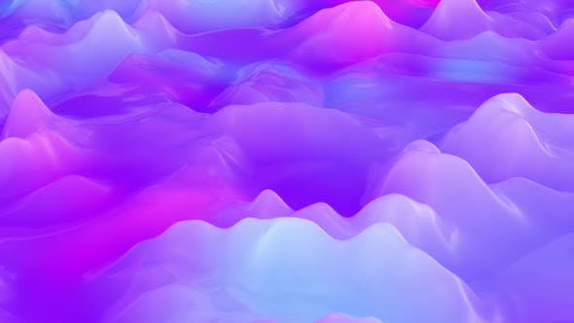
PROBLEM
process can be time-consuming
existing generators are scattered
What if…

Slide 4
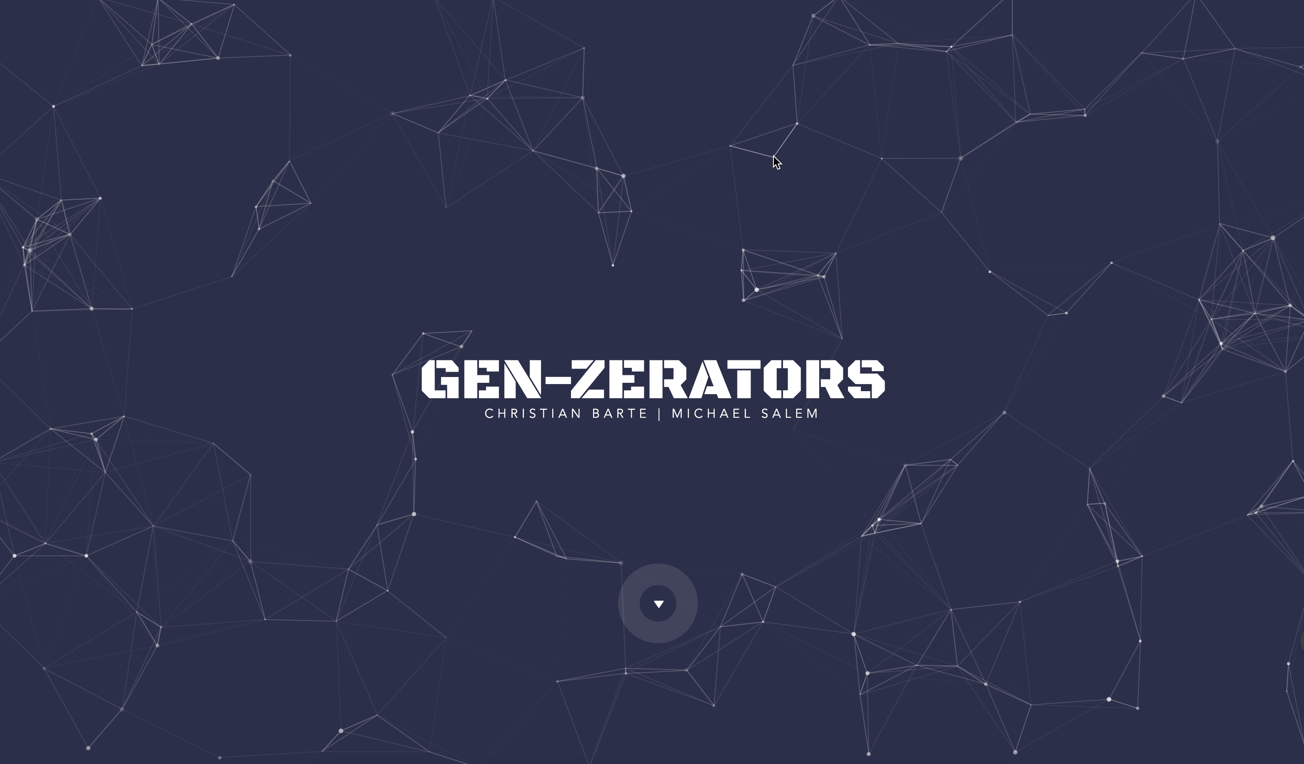
PROBLEM
process can be time-consuming
existing generators are scattered
What if…
OUR SOLUTION

Slide 5
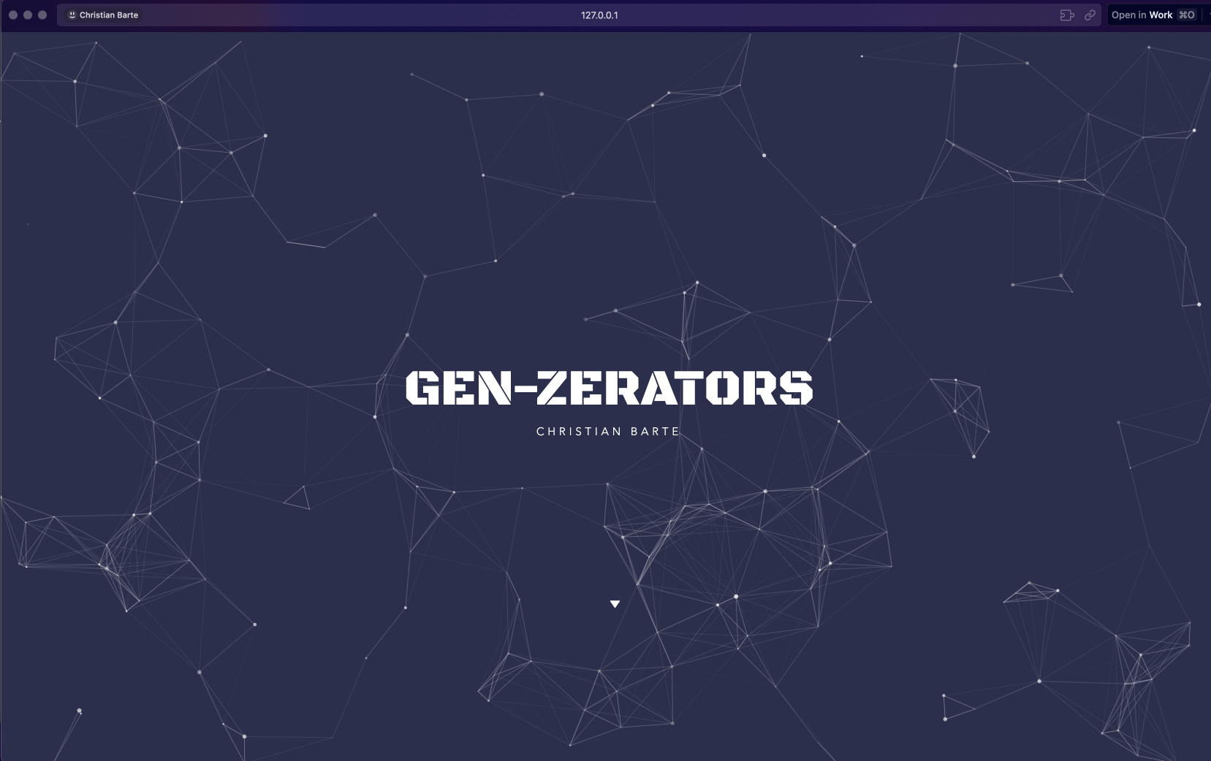

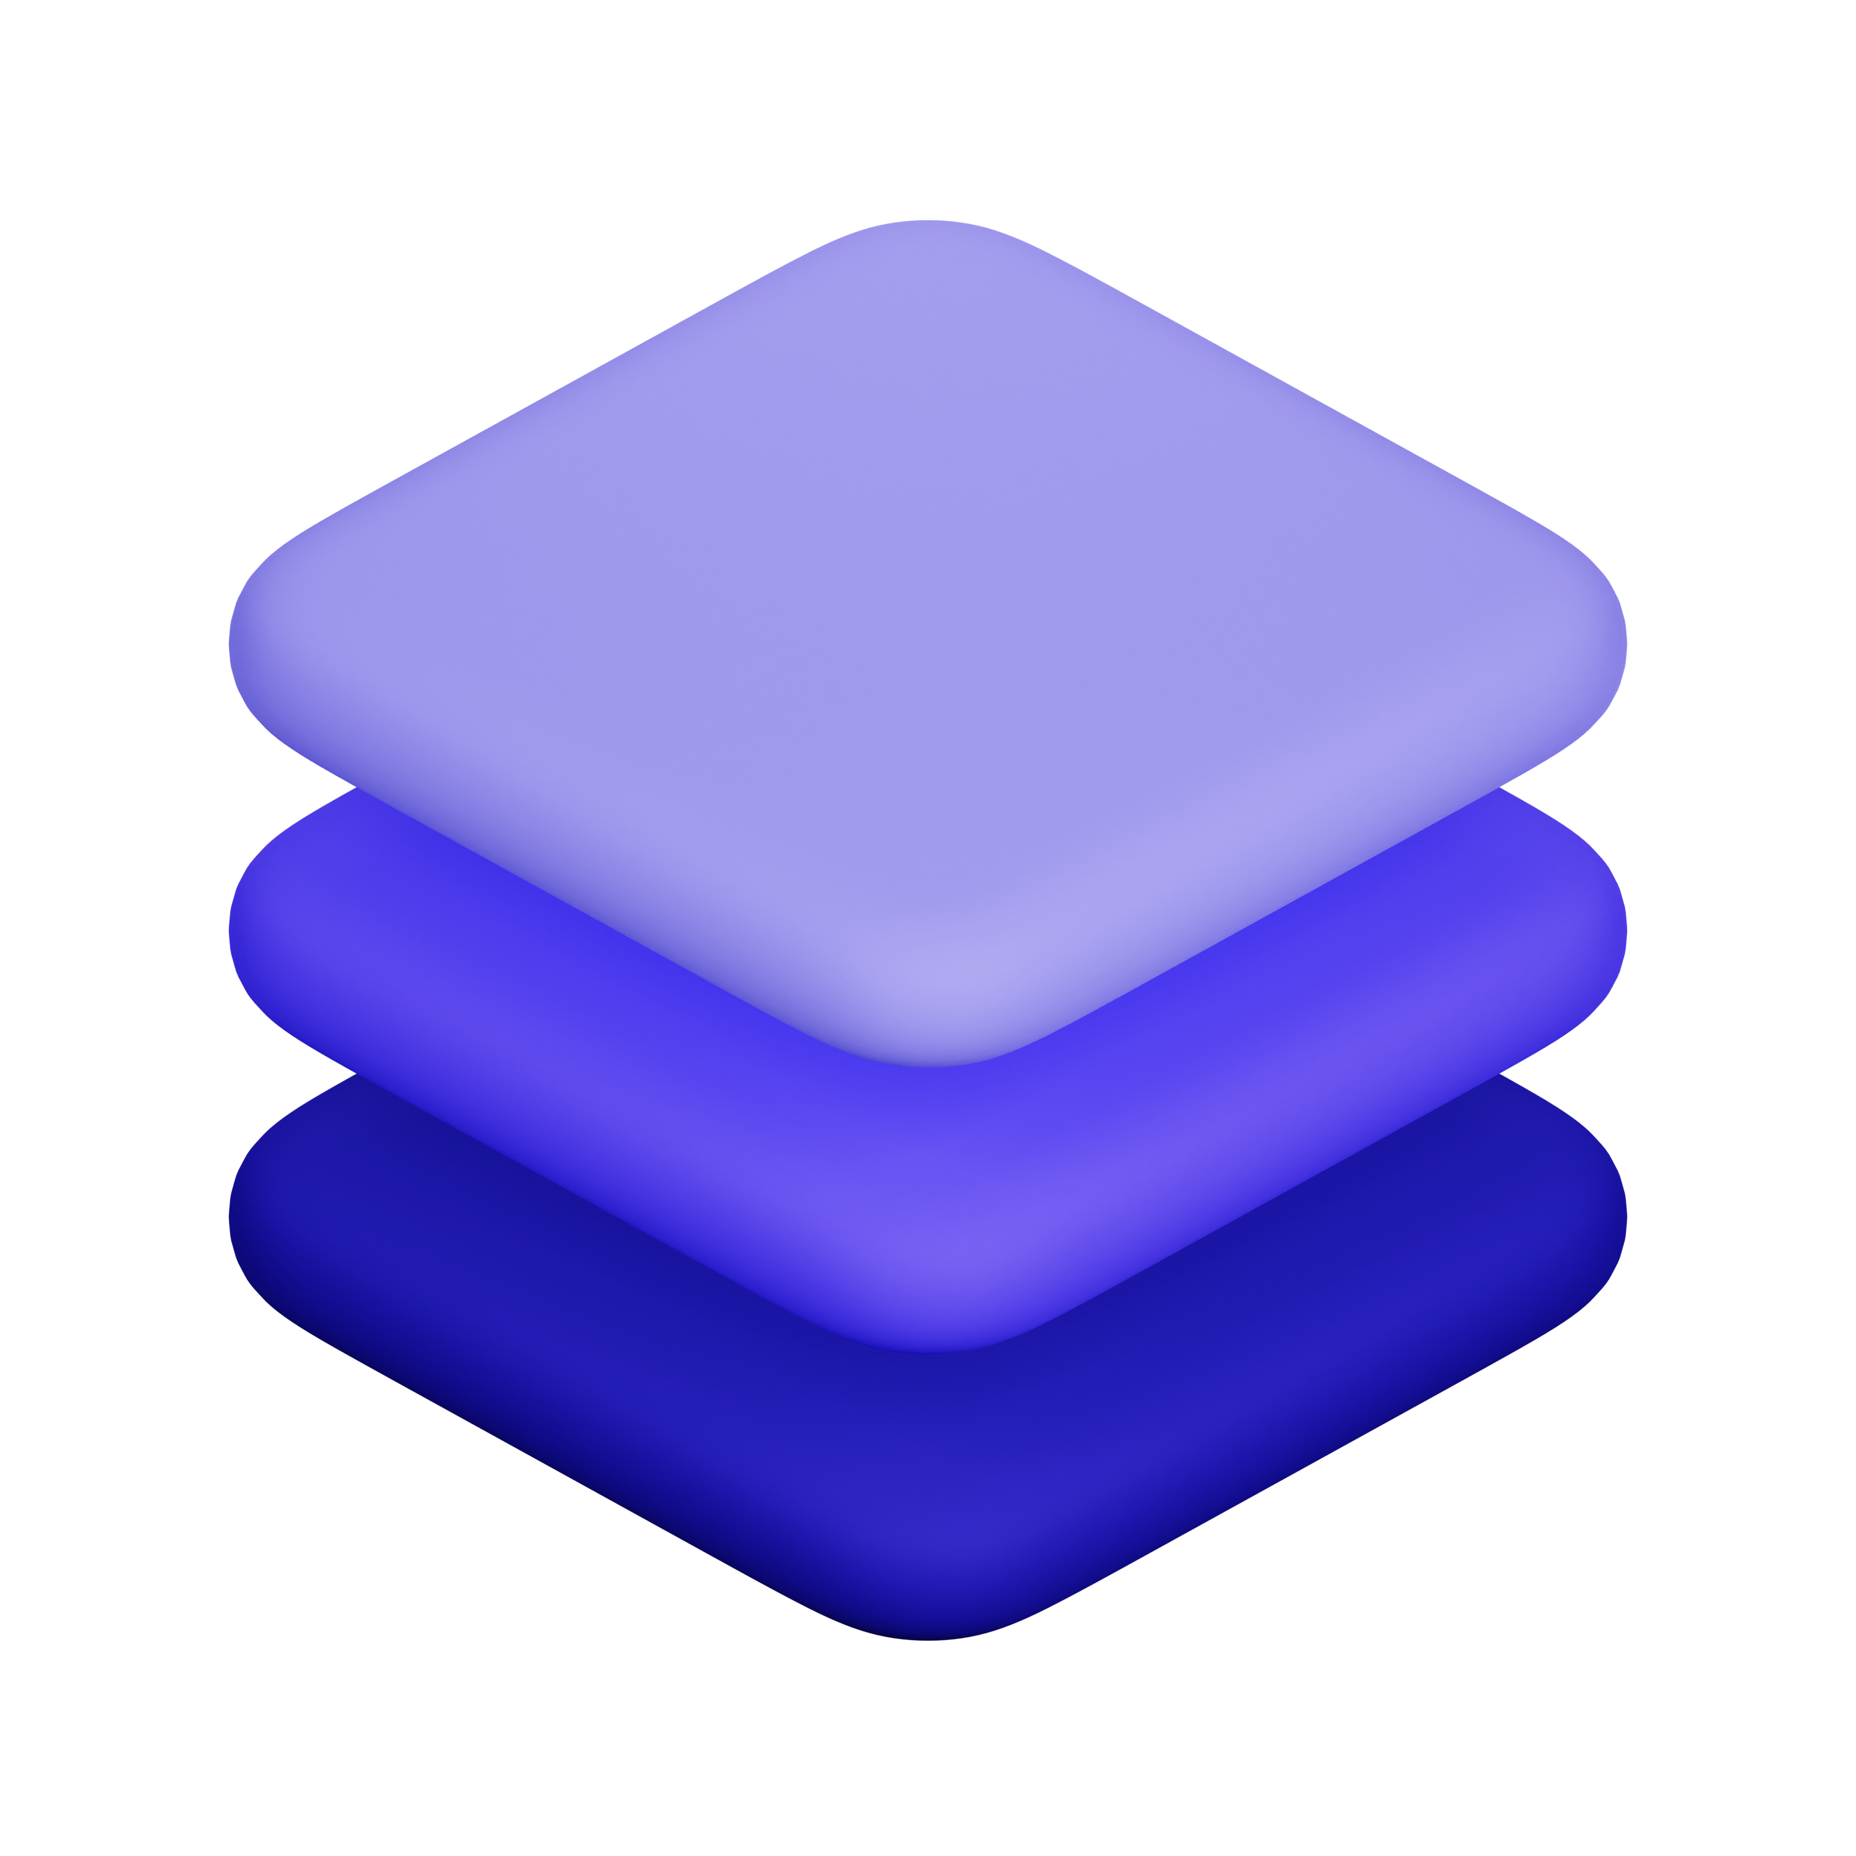

What if…
OUR SOLUTION
CURRENT FEATURES
glassmorphism
box shadow
gradiefy

Slide 6
OUR SOLUTION
CURRENT FEATURES
glassmorphism
box shadow
gradiefy

Slide 7


CURRENT FEATURES
a design trend that creates a glass-like effect by using blurred backgrounds, semi-transparent panels, and subtle shadows to give the appearance of depth and a frosted glass look
glassmorphism
box shadow
gradiefy

Slide 8
CURRENT FEATURES
box shadow
a styling property in graphic design that adds a shadow effect to an element, such as a box or text, creating the illusion of depth and making the element appear lifted off the page
glassmorphism
gradiefy

Slide 9
CURRENT FEATURES
a gradual transition between two or more colors or shades. In graphic design, gradients are often used to create smooth color transitions
gradiefy
glassmorphism
box shadow

Slide 10

UPCOMING FEATURES
Neumorphism
Color extractor
Image generator
Color convert

Slide 11
DEMONSTRATION

